Slide 1
Stochastic Yan Network
04/06/2015
Herman Gudjonson

Slide 2
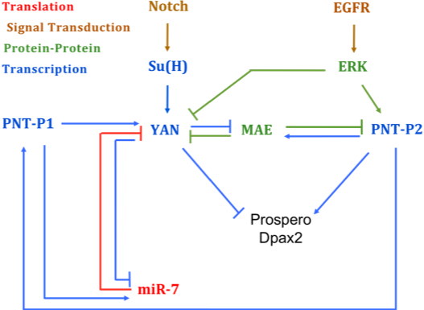
Network Components

Slide 3
Stochastic Model Features
Yan dimer explicitly accounted for
Yan and PntP2 phosphorylation
Mae-Yan, Mae-PntP2p, miR7-mYan
Mae, miR7 promoter site occupancy by Yan/Pnt
Time-dependent Notch signal sets rate of mYan induction
Time-dependent EGFR signal sets rate of Yan/PntP2 phosphorylation
More details in written document!

Slide 4
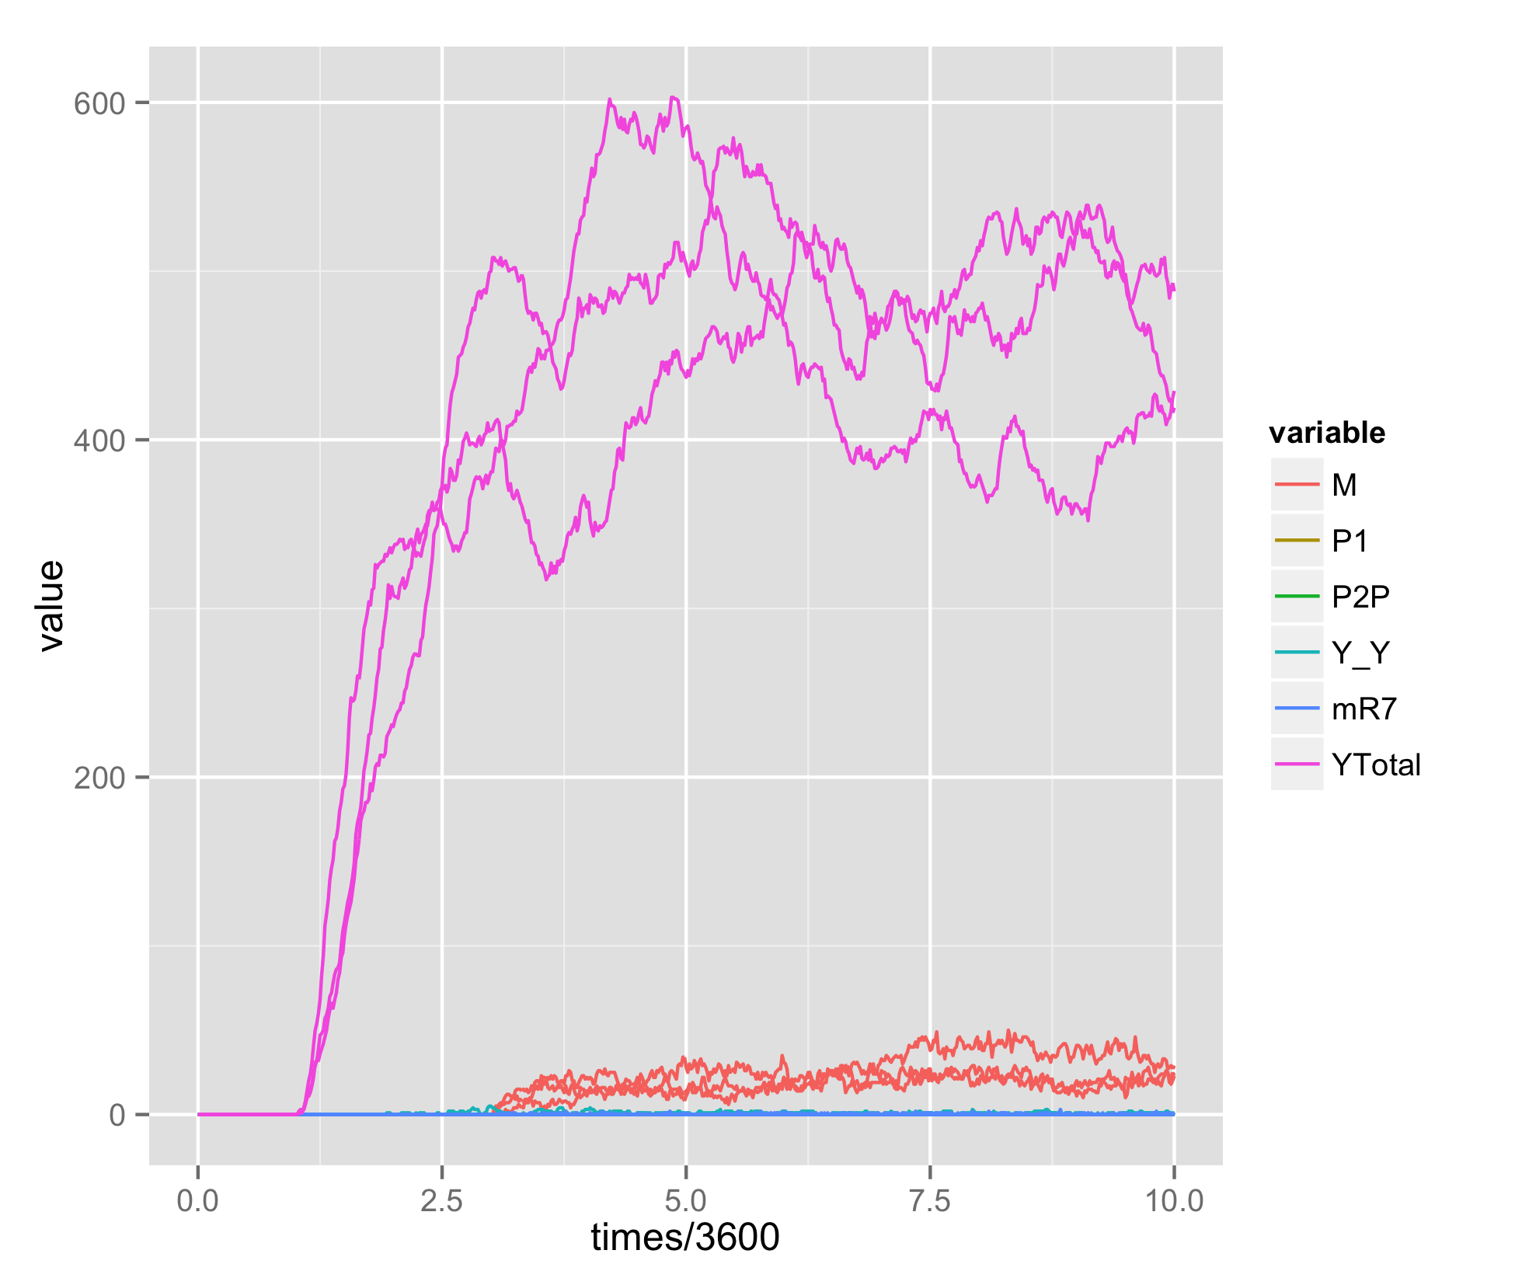
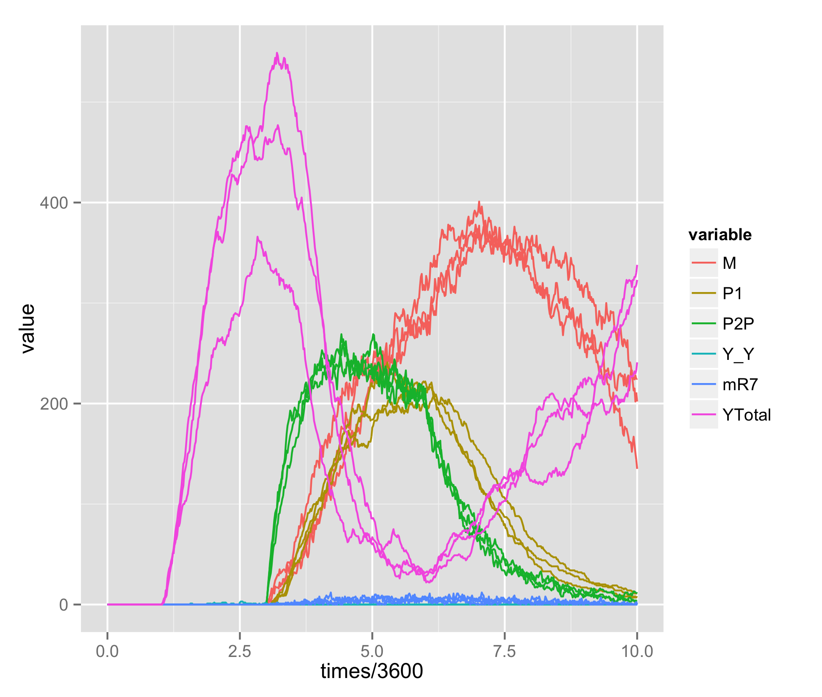
Yan degradation following EGFR Signal
EGFR
Notch
Notch
31 total reactions
~43,000 reaction events per simulation
Timescale of quickest process ~30 seconds

Slide 5
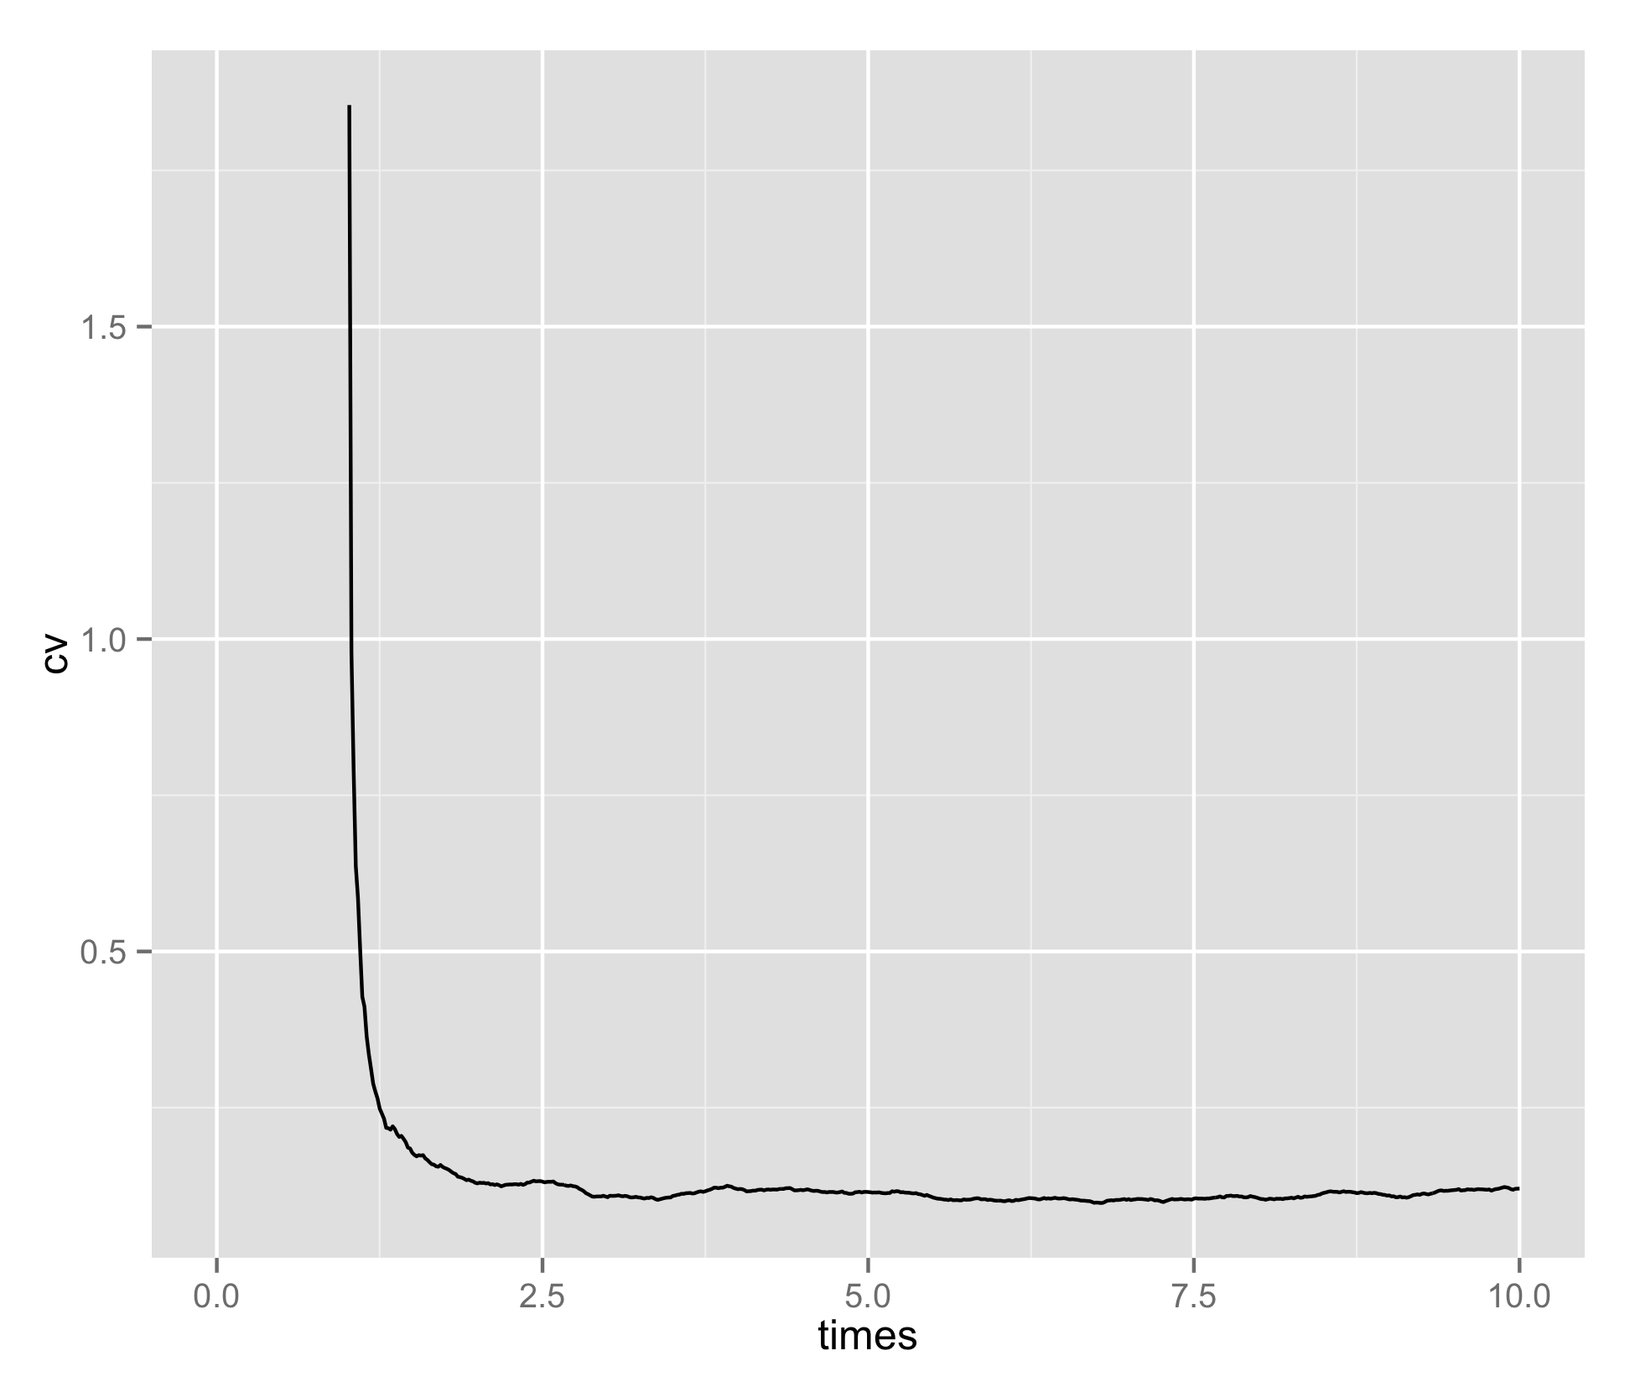
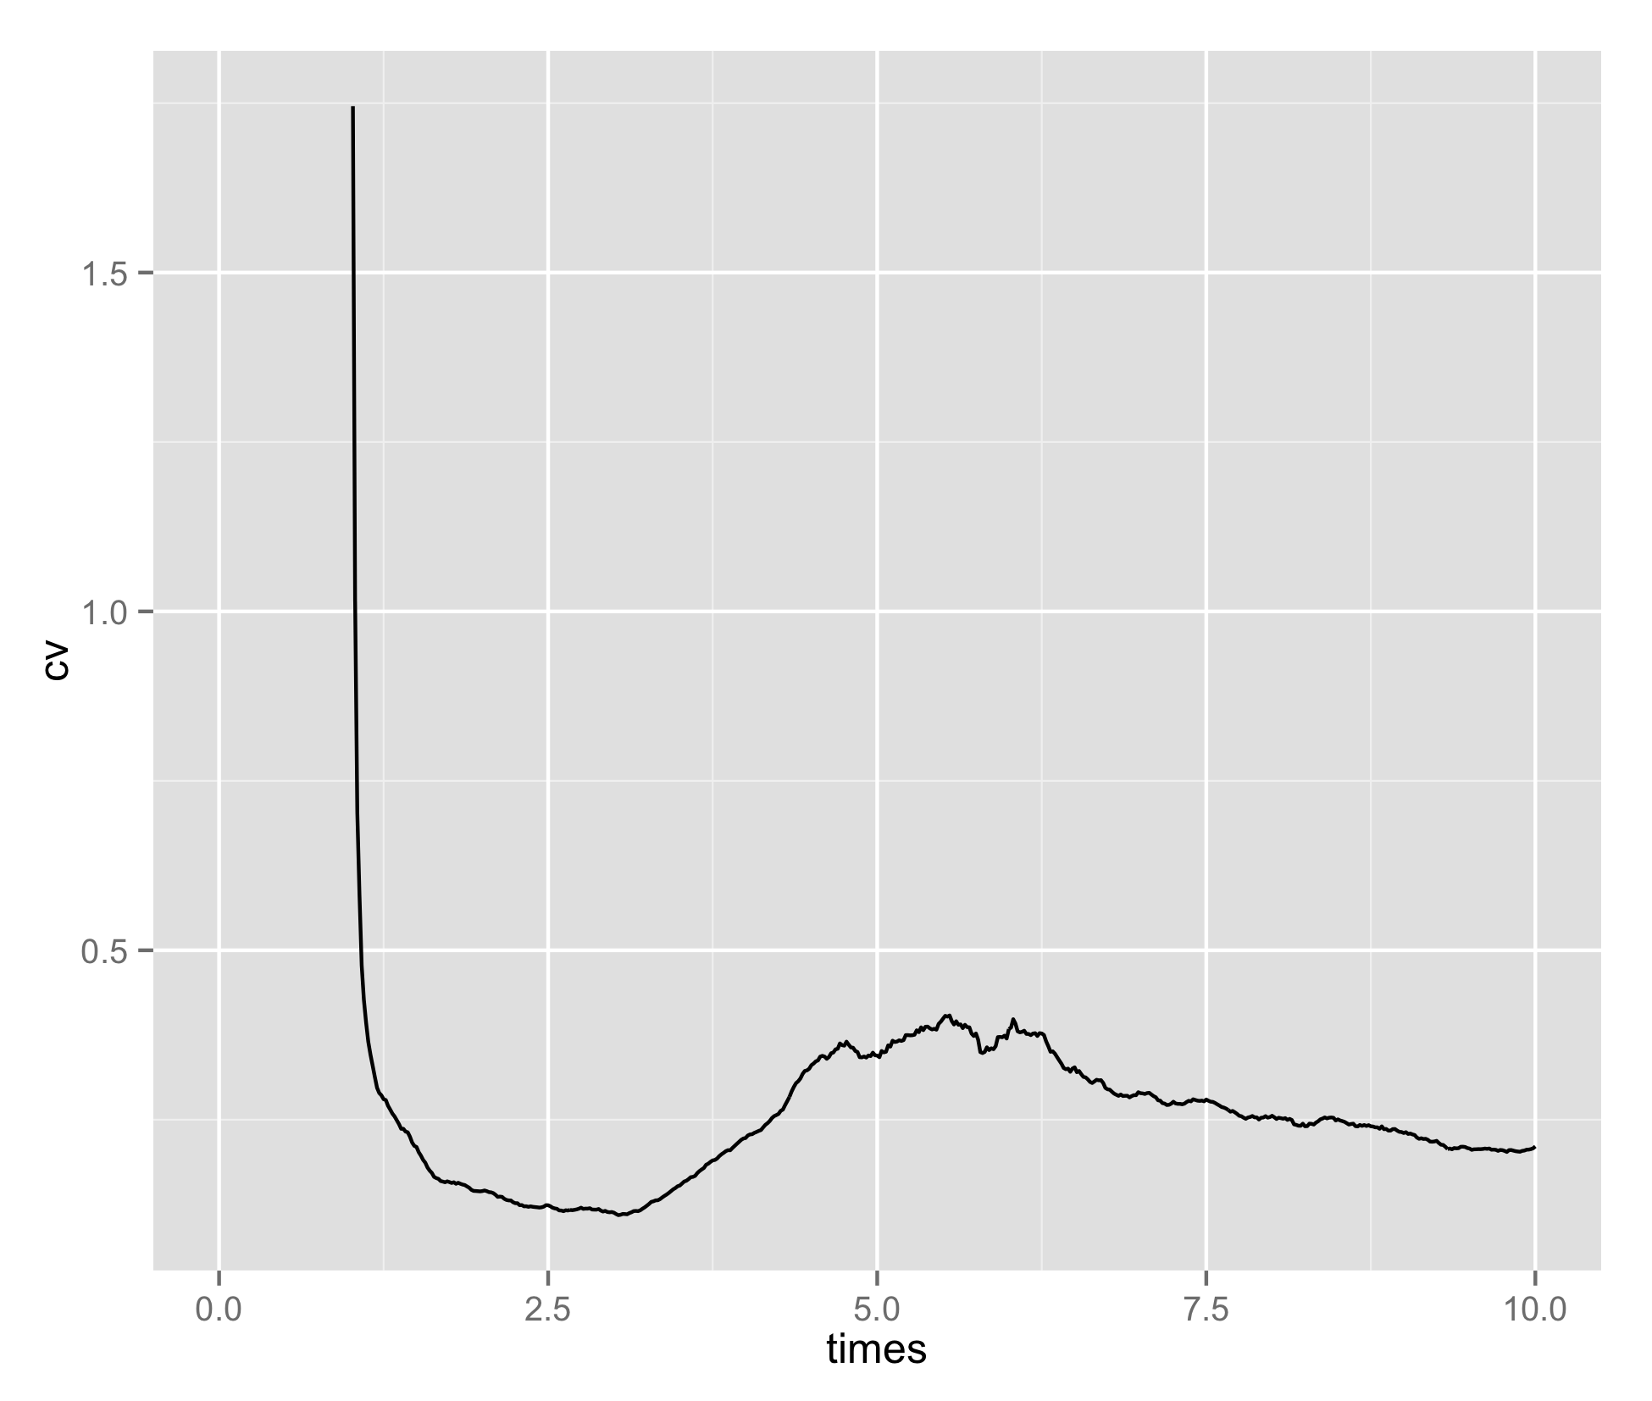
Yan Coefficient of Variation Artifact?
EGFR
Notch
Notch
Calculated from 100 independent trials

Slide 6
General Timescale Assumptions
Default mean RNA lifetime ~10min
Default mean protein lifetime ~1hr
Phosphorylated Yan ~5min
Time to phosphorylate per dpMapk ~1min
Complex mean lifetime ~5min
Mae-YanP ~30sec for rapid dissociation
Protein copy number ~500
RNA copy number ~20

Slide 7
Appropriate start for Mae induction?
EGFR
Notch
Prior to Yan induction, the promoter of Mae and miR7 in the model is unbound and poised for translation
I suppress this by only allowing Mae and miR7 to be produced after EGFR signal is started

Slide 8
Stability of low Yan state?
EGFR
Notch
As constructed, PntP1 requires PntP2p for induction
When EGFR signal is lost PntP1, Mae and miR7 degrade and Yan levels rise once again
In the Graham et al. 2010 model, there is positive feedback built in for PntP1 (induction requires either PntP2p or PntP1) which establishes bistability

Slide 9
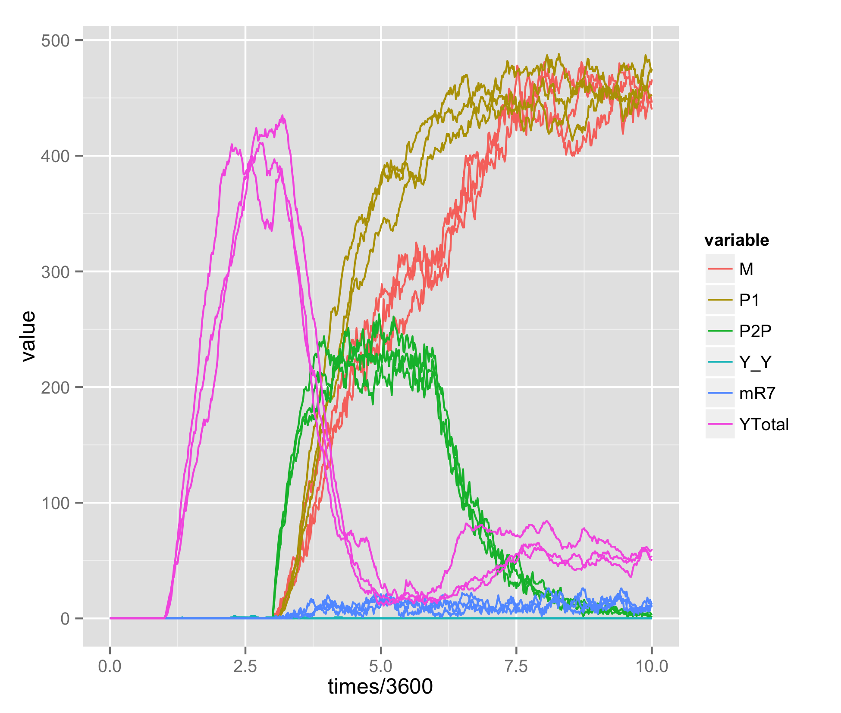
Including PntP1 Feedback
EGFR
Notch
Low Yan state is now stable, although there is still slight upregulation of Yan post-EGFR

Slide 10
Mae/miR7 promoter site model
dGets = 10 kcal (56nM)
dGns = 5.8 kcal (50uM)
dGsam = 7 kcal (7uM)
dGpnt = 9.7 kcal (100nM)
Following Matt Hope’s thermodynamic multi-site model for Yan binding
Z = 1 +
+ [Y] exp(dGets/KbT) + [Y] exp(dGns/KbT)
+ [Y]² exp((dGets + dGns + dGsam)/KbT) + [Y-Y] exp((dGets + dGns)/KbT)
+ [P1] exp(dGpnt/KbT) + [P2p] exp(dGpnt/KbT)
dimer Yan - repressive
Y
Y
unbound
dGets + dGns (+ dGsam)
NS
ETS
NS
ETS
Y
dGets
P1
dGpnt
NS
ETS
NS
ETS
single Yan
Pnt bound - activating
Y
P2p
dGns
dGpnt
NS
ETS
NS
ETS

Slide 11
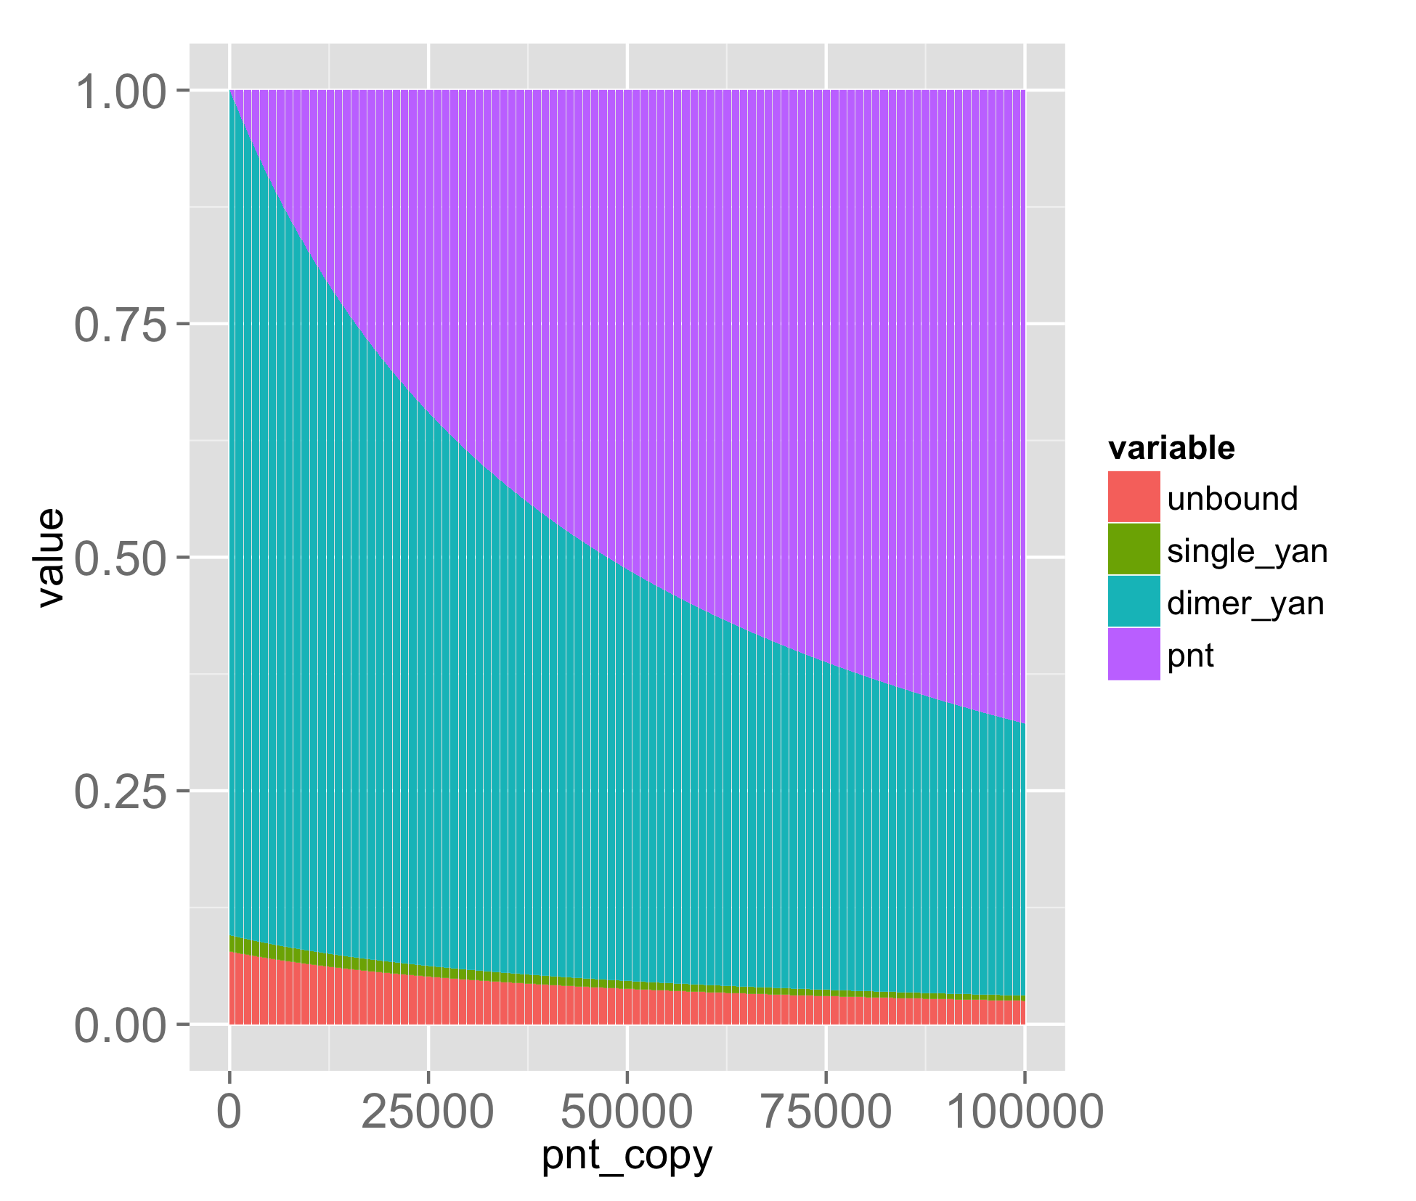
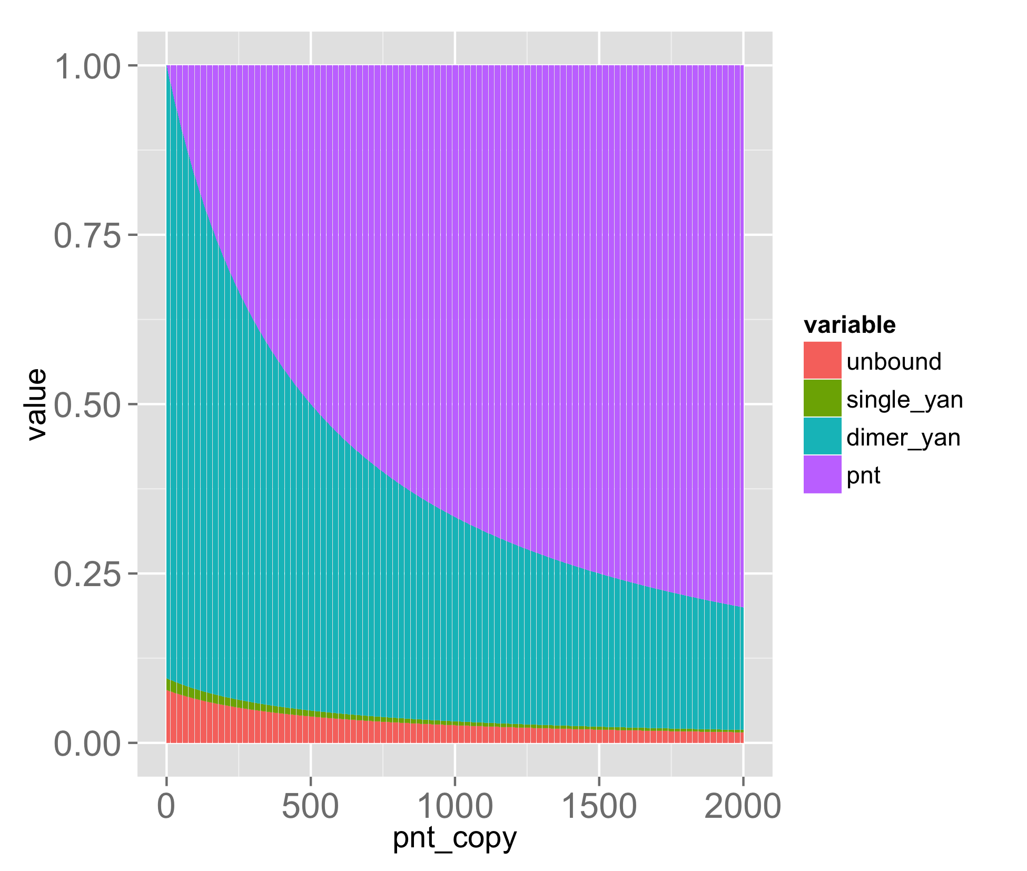
Weak Pnt binding relative to Yan Dimer?
YTotal = 500
dGP = 9.7 kcal (100nM)
YTotal = 500
dGP = 12.4 kcal (1nM)
At ~150 copies of Yan, dimer bound fraction equals unbound fraction
Relative activity of states could also account for Pnt action
Binding energies determine appropriate copy number ranges

Slide 12
Parameter inference from Experimental Data
Experimental Yan induction curve could roughly estimate the Yan degradation rate
If dx/dt = a – bx, then x(t) = (a/b) + C₀ e^(-bt)
Experimental Yan degradation curve in differentiating cells roughly estimate Yan-P degradation rate

Slide 13
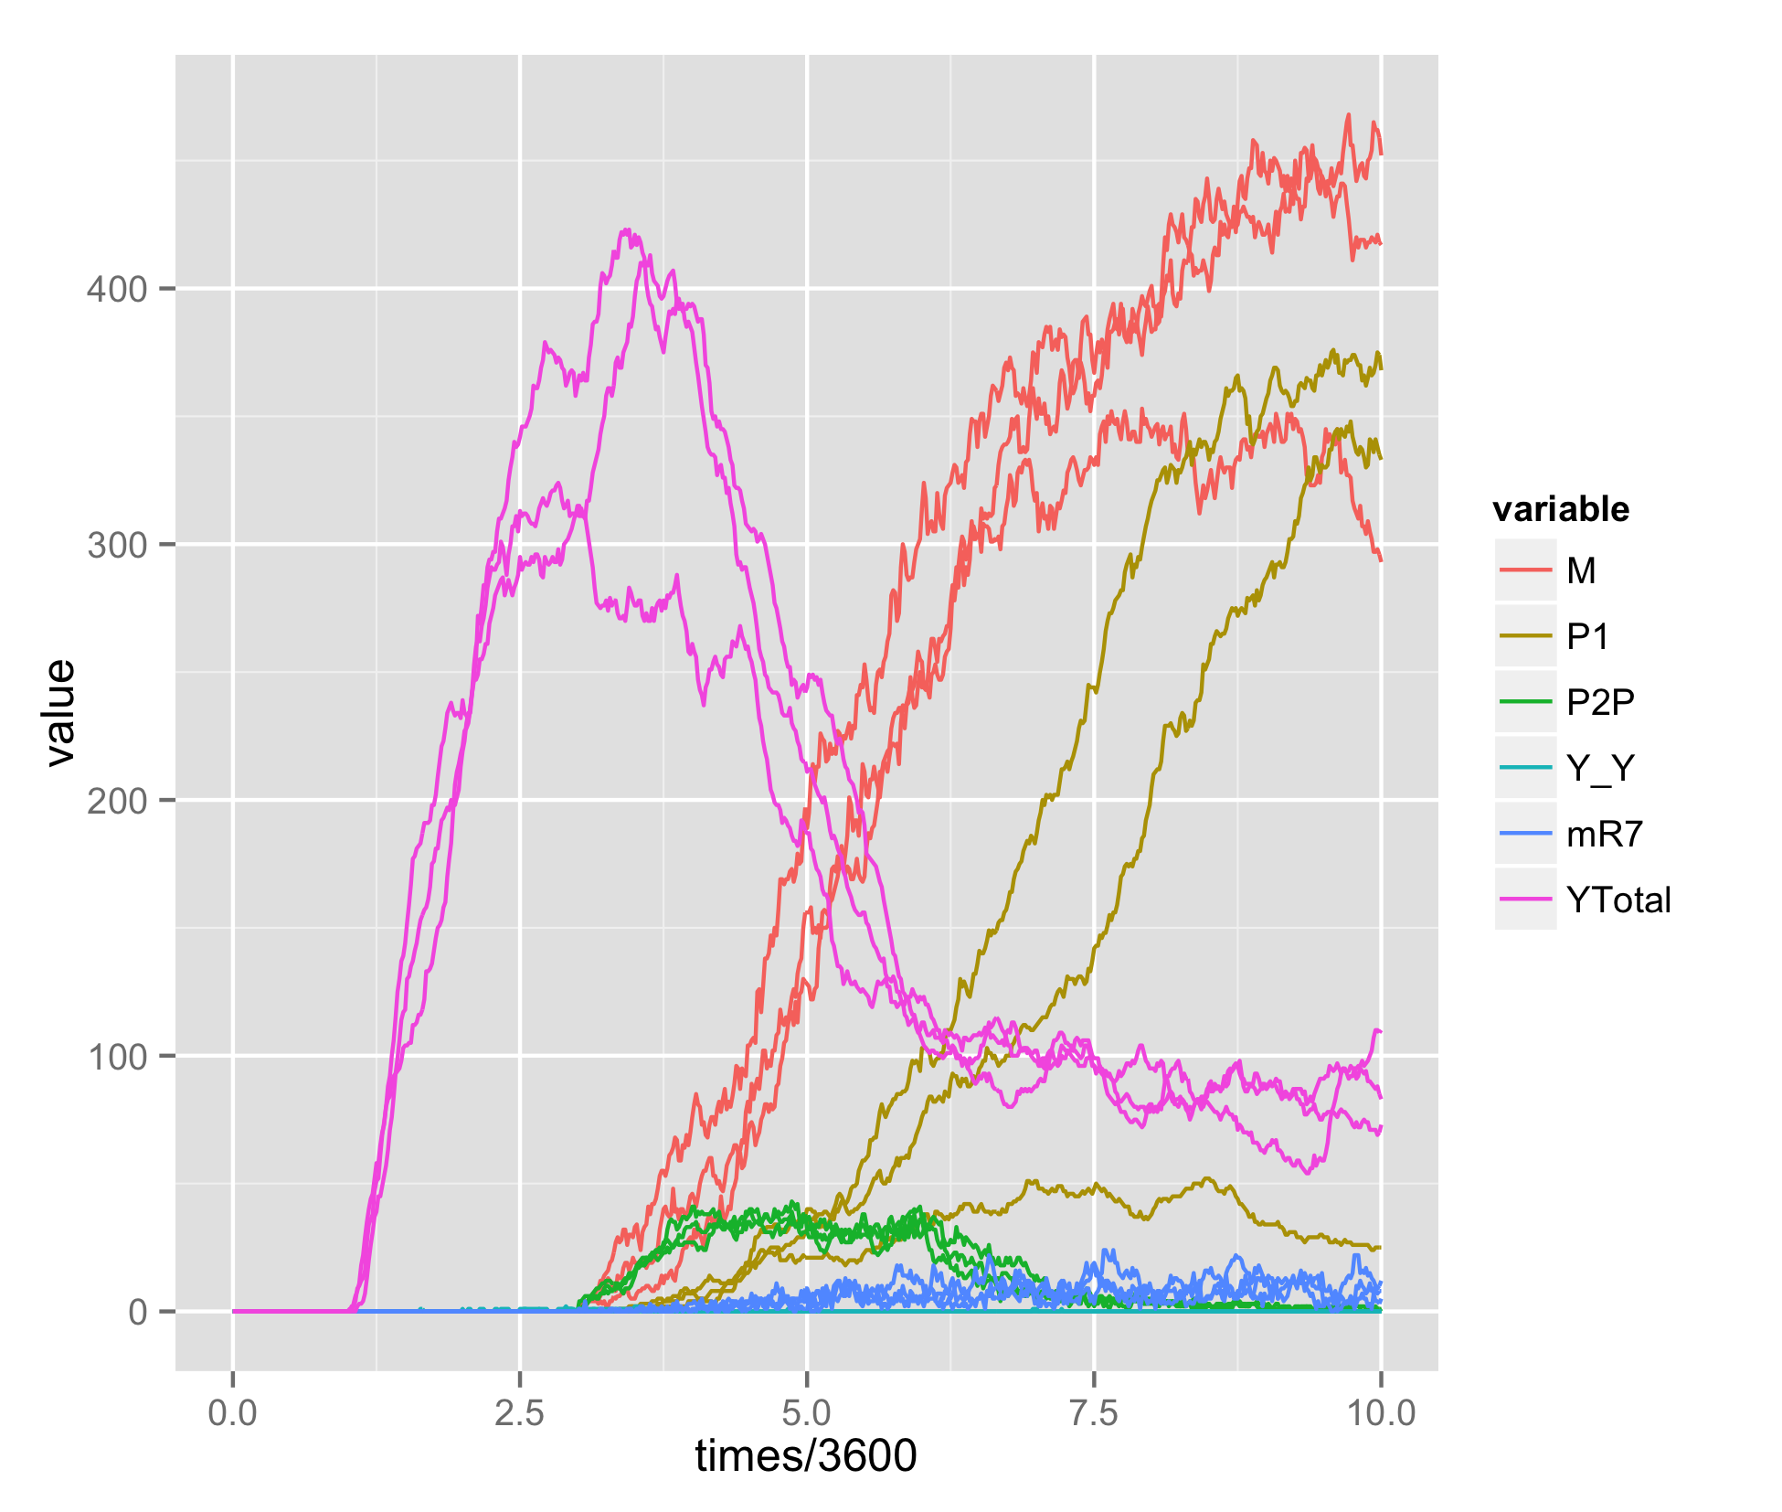
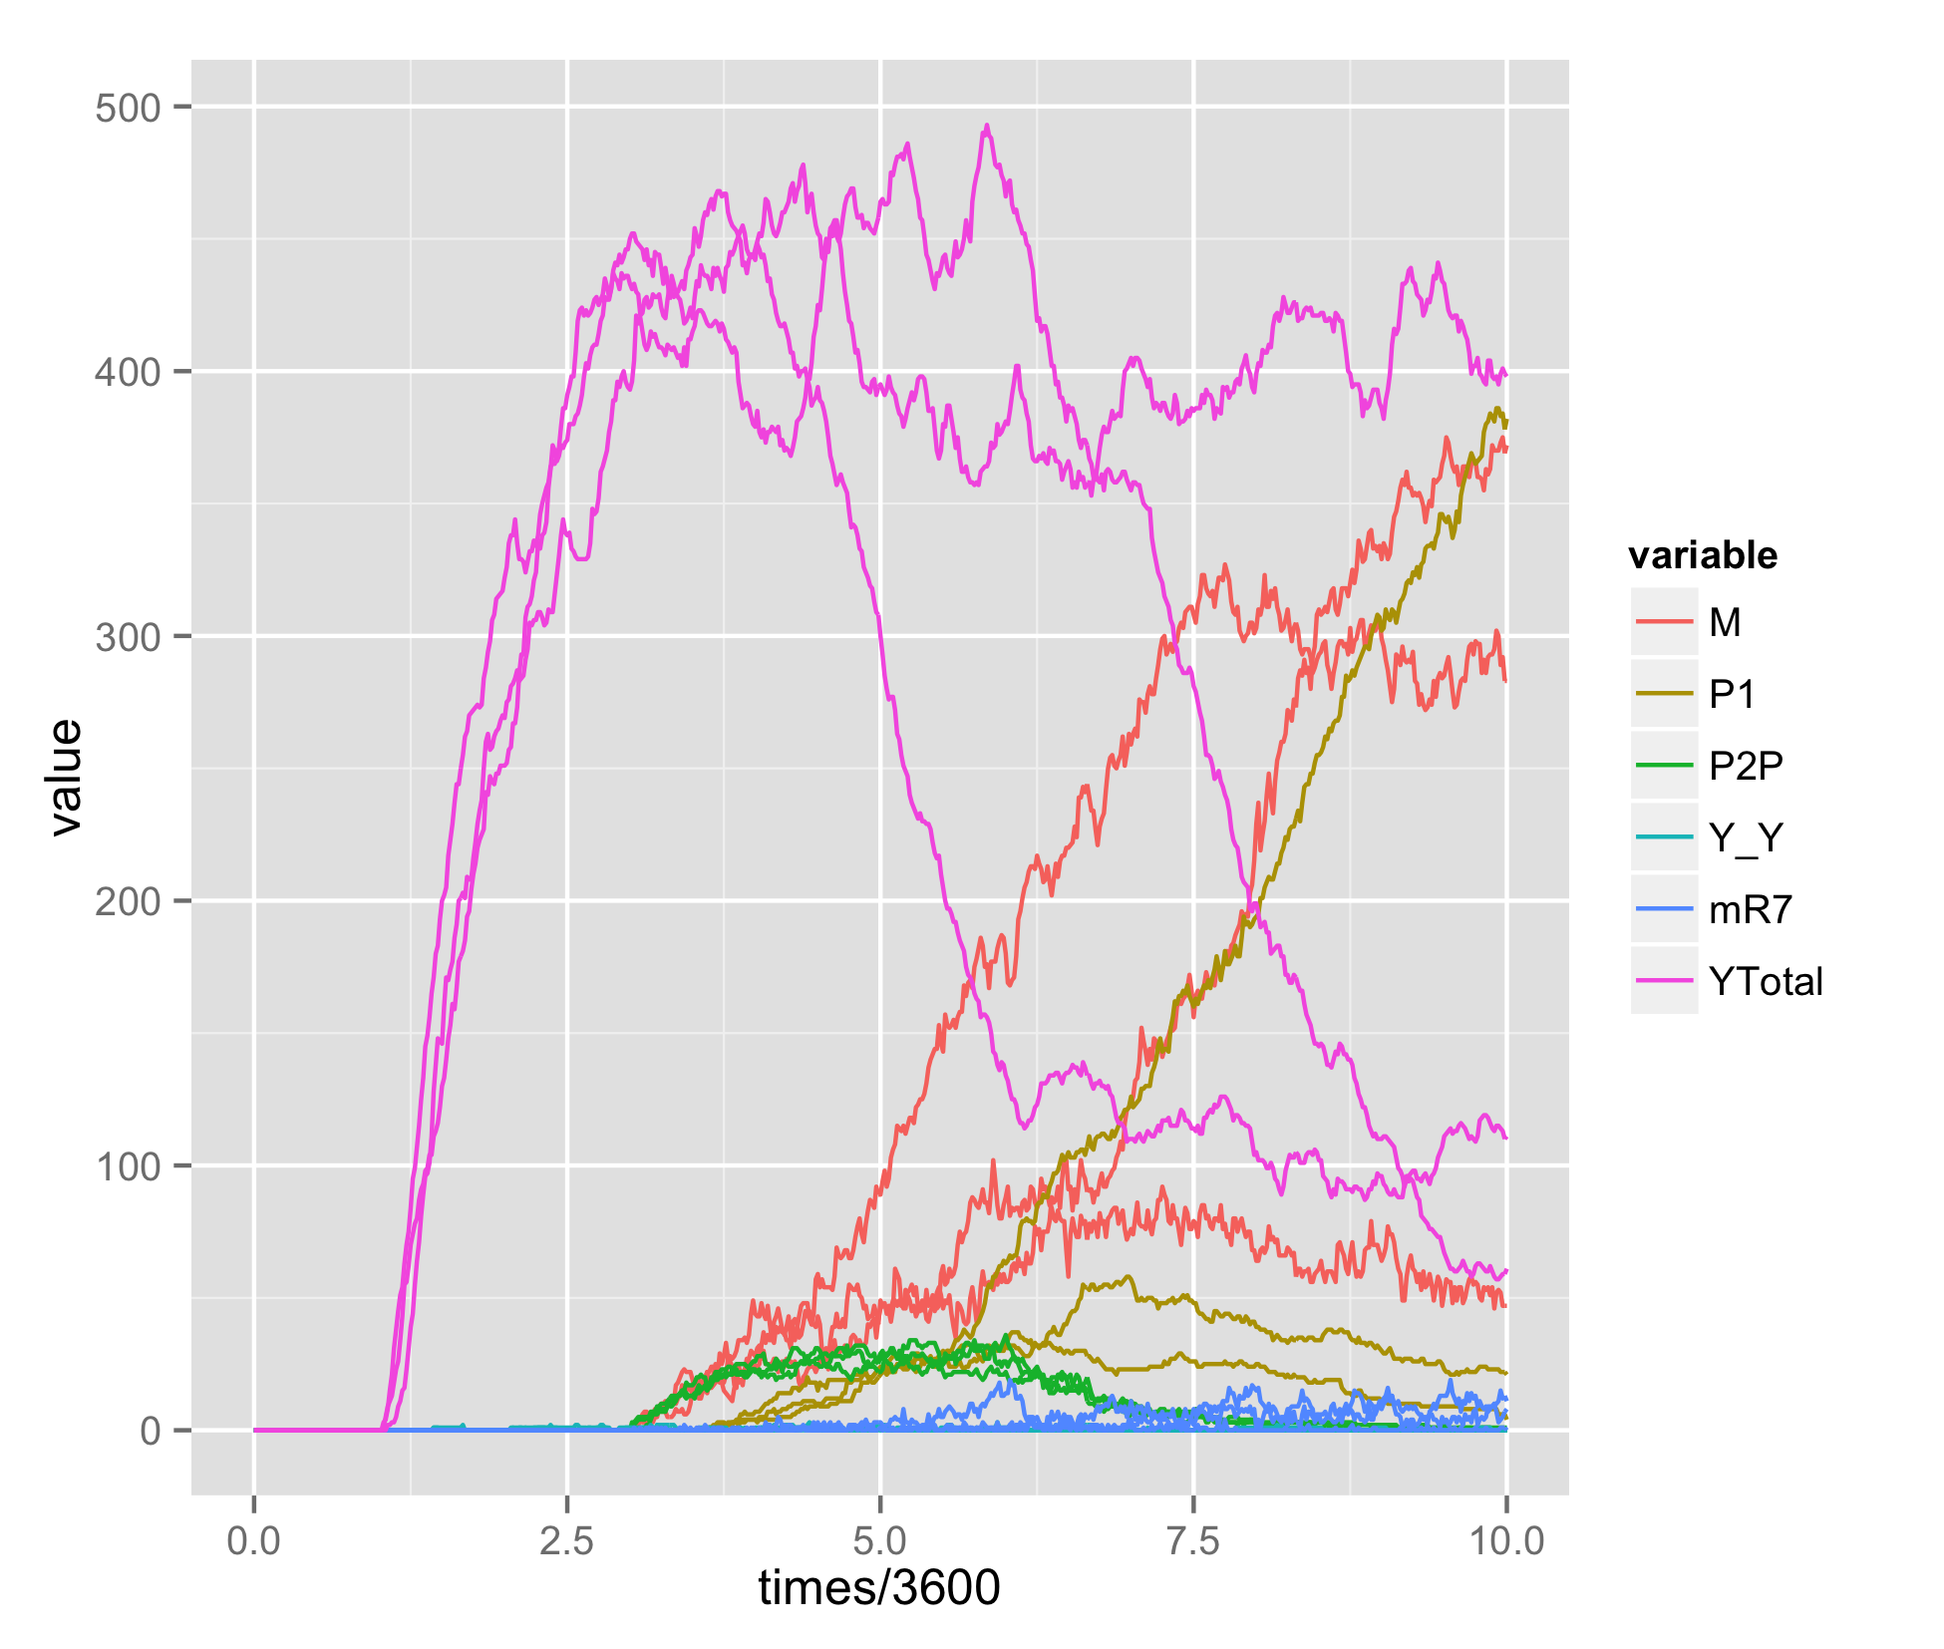
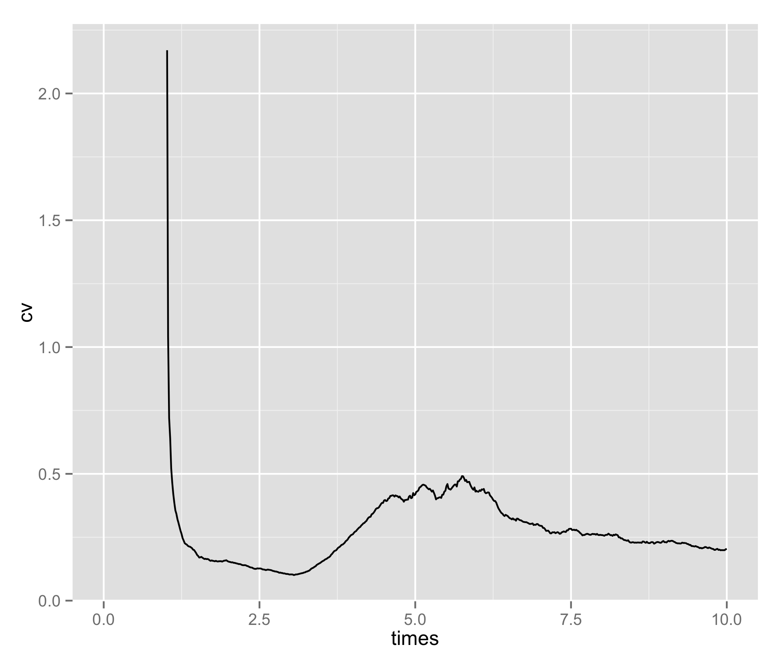
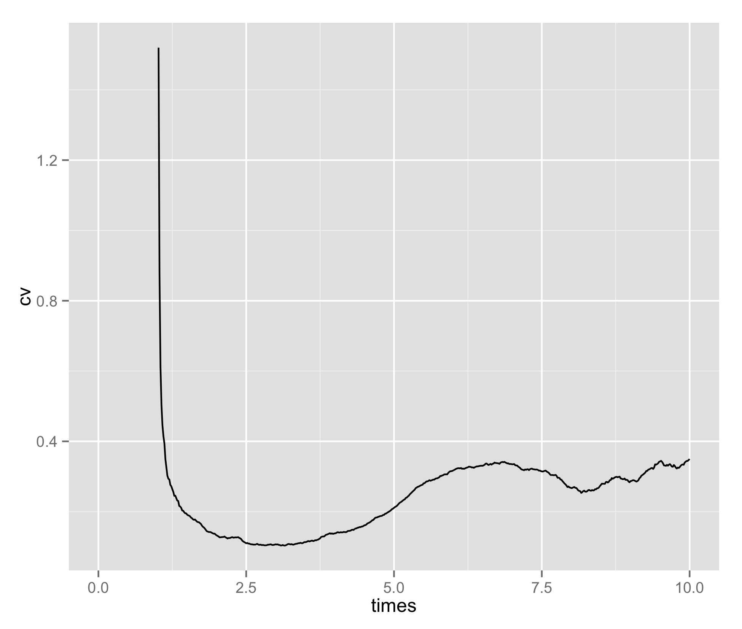
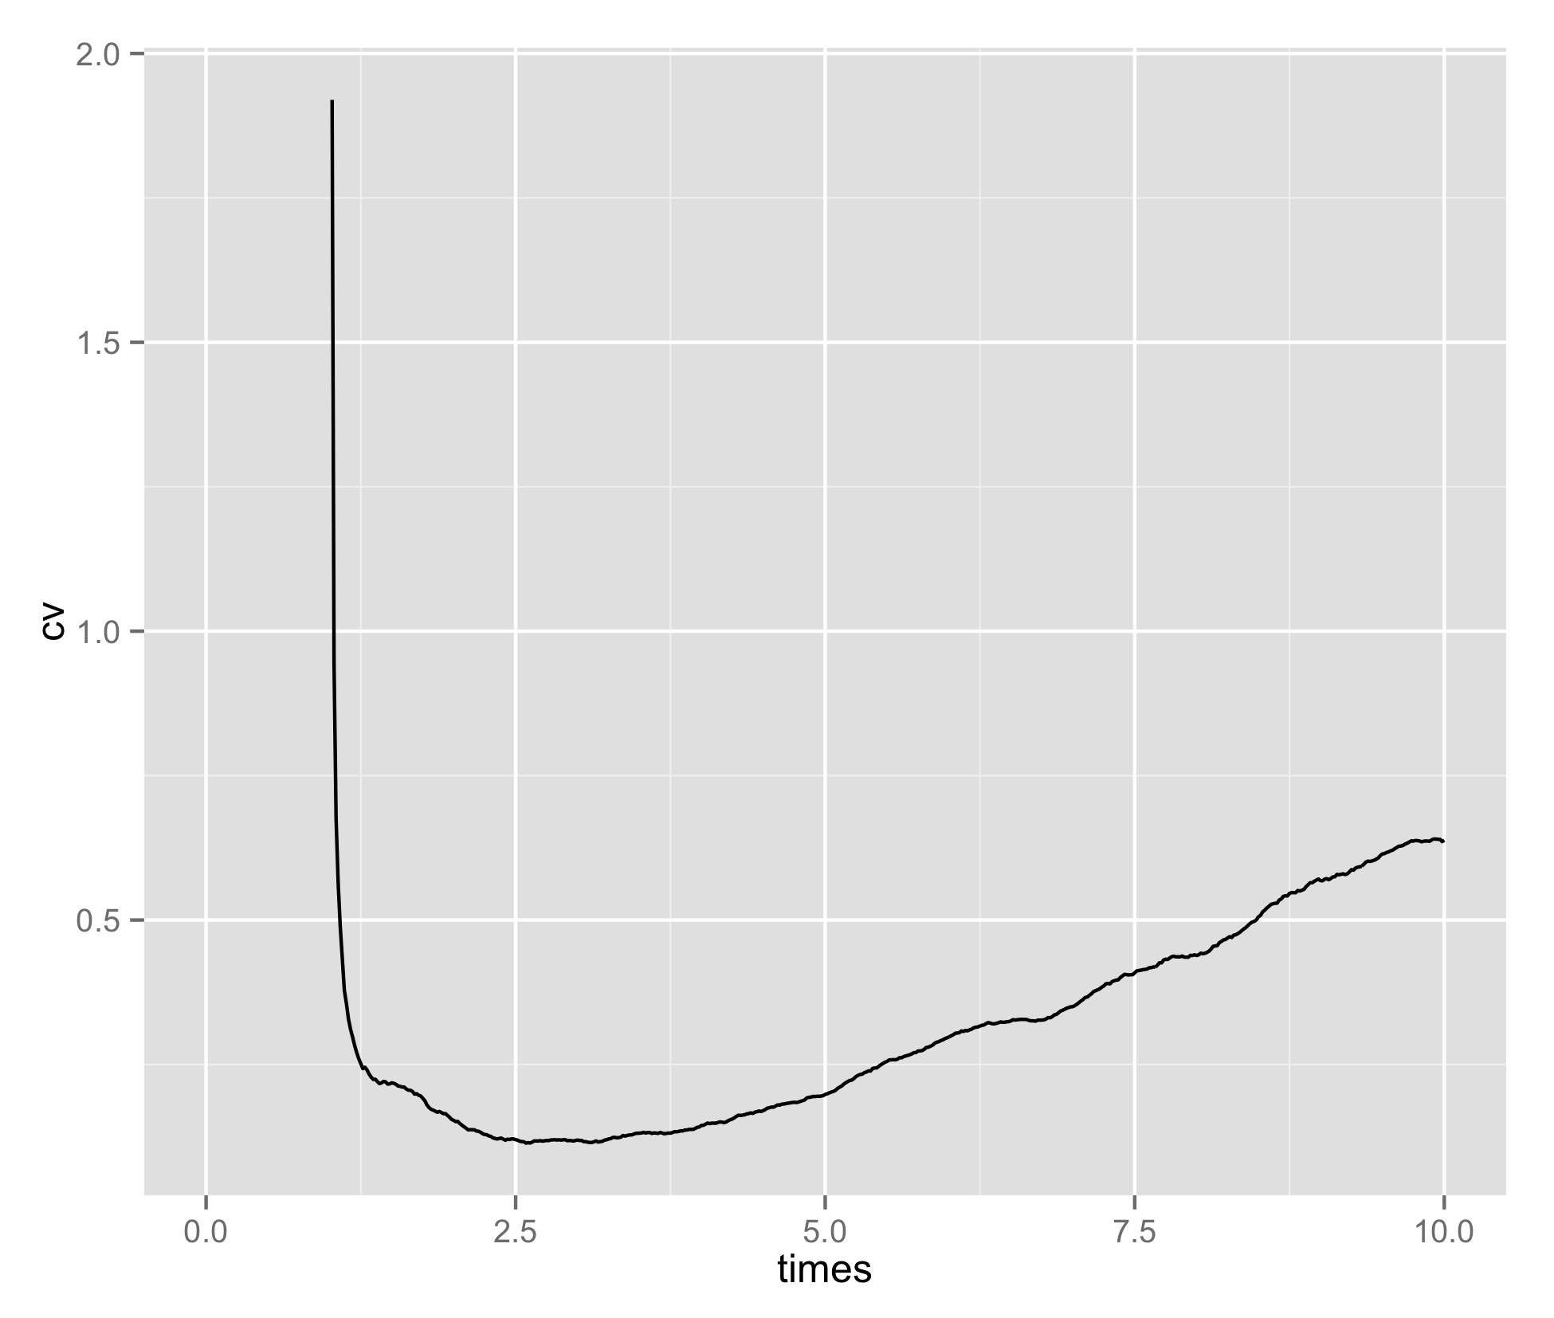
Varying EGFR signaling levels
EGFR=10
EGFR=1
EGFR=0.75
Notch
Notch
Notch

Slide 14
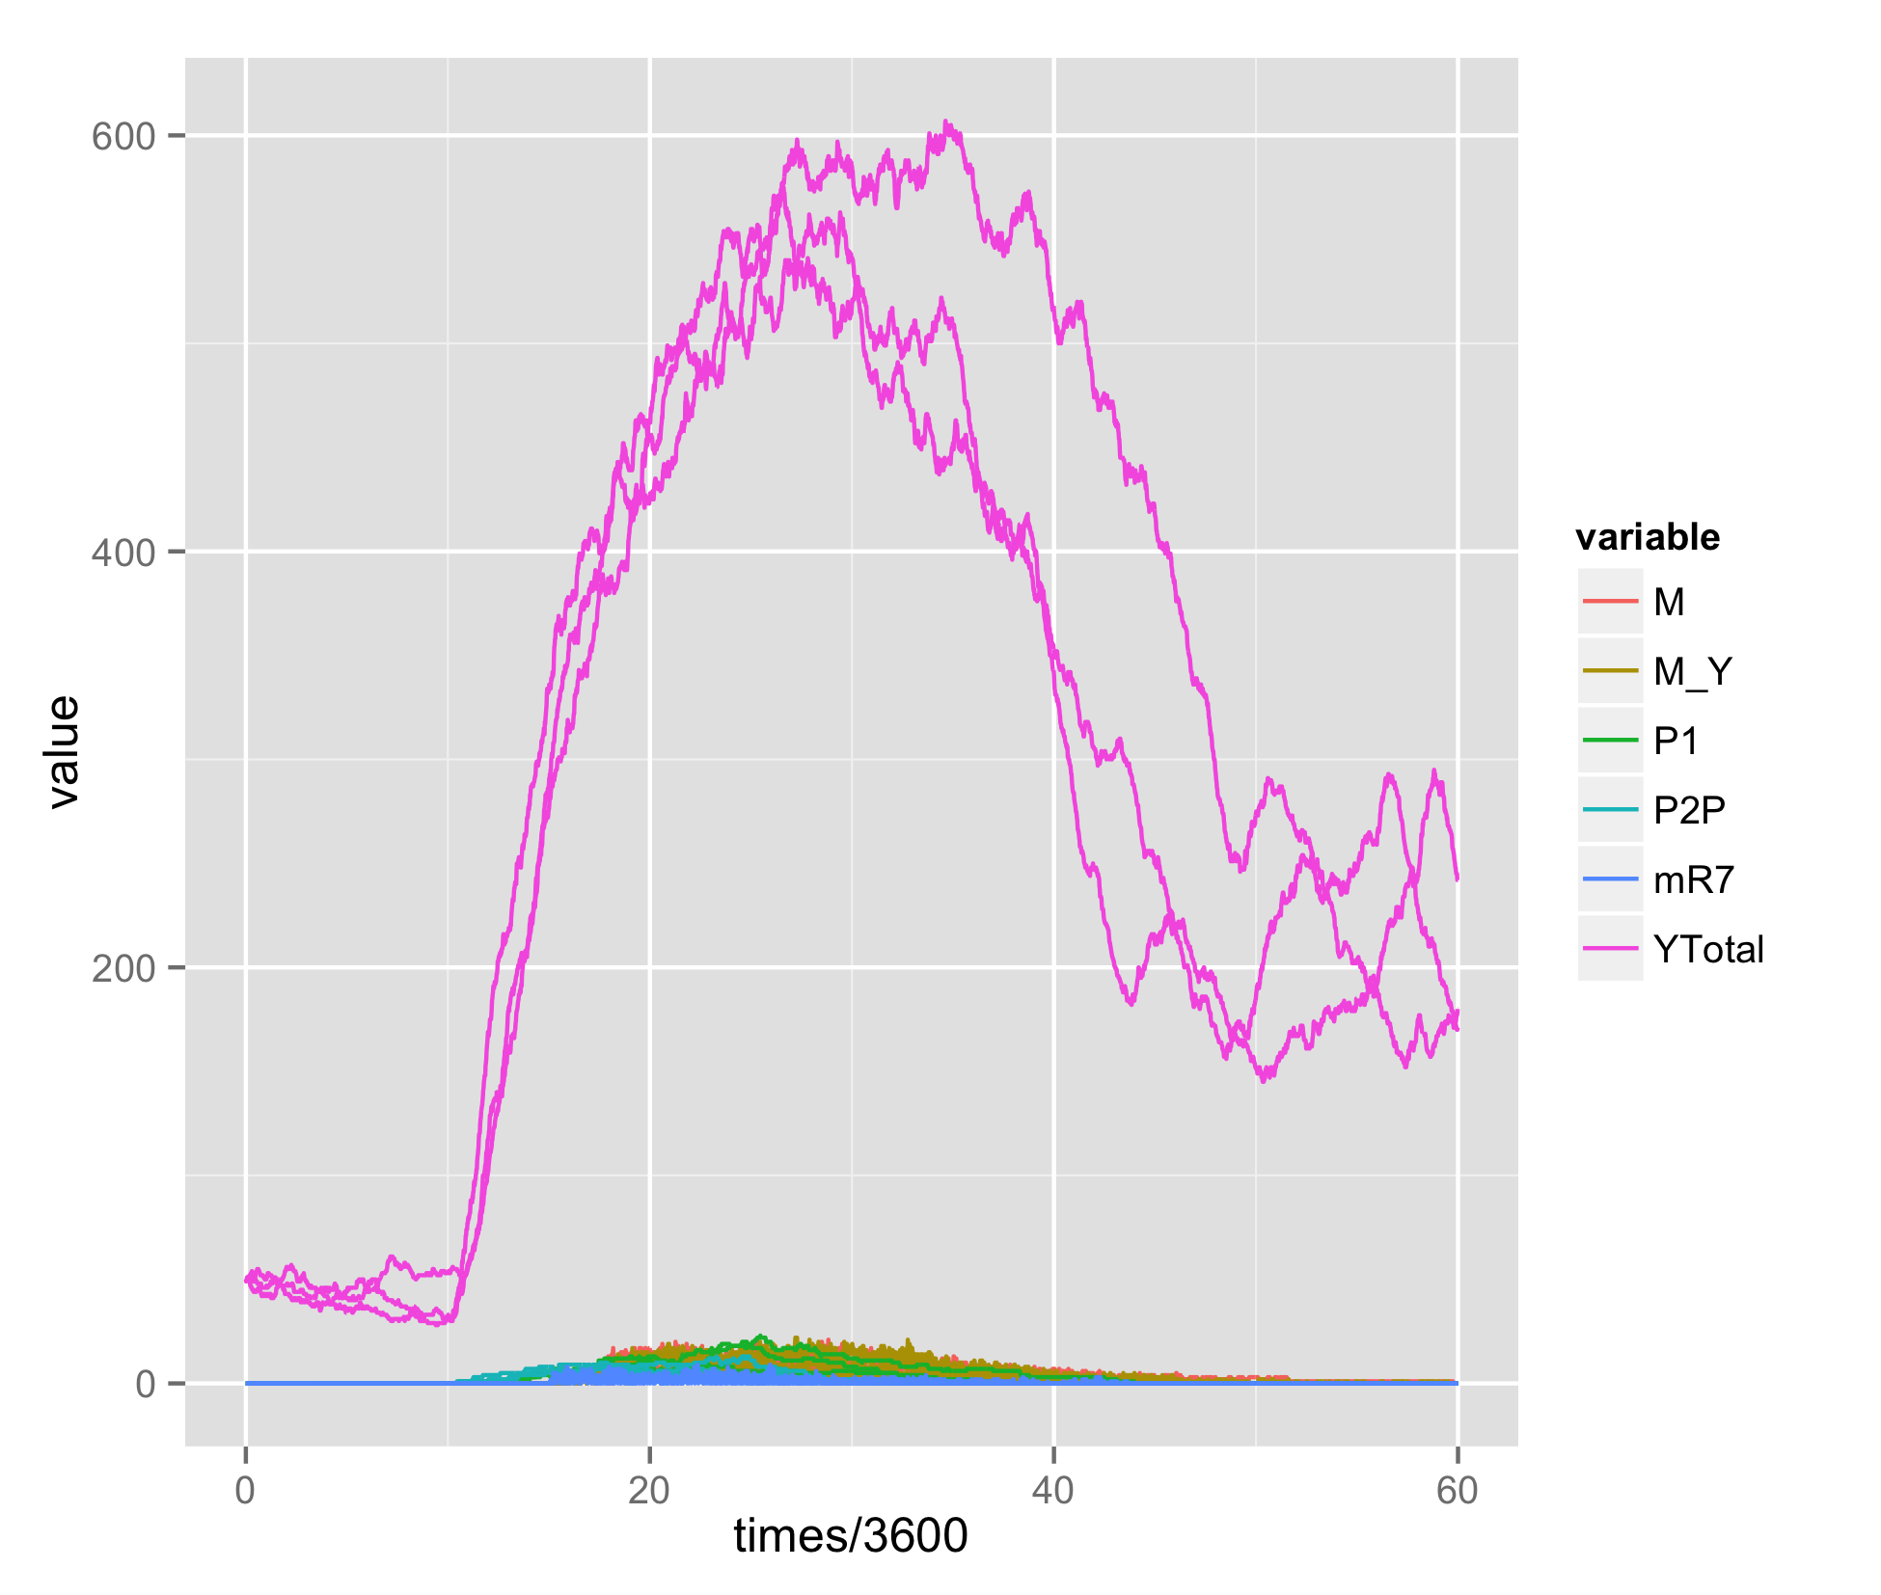
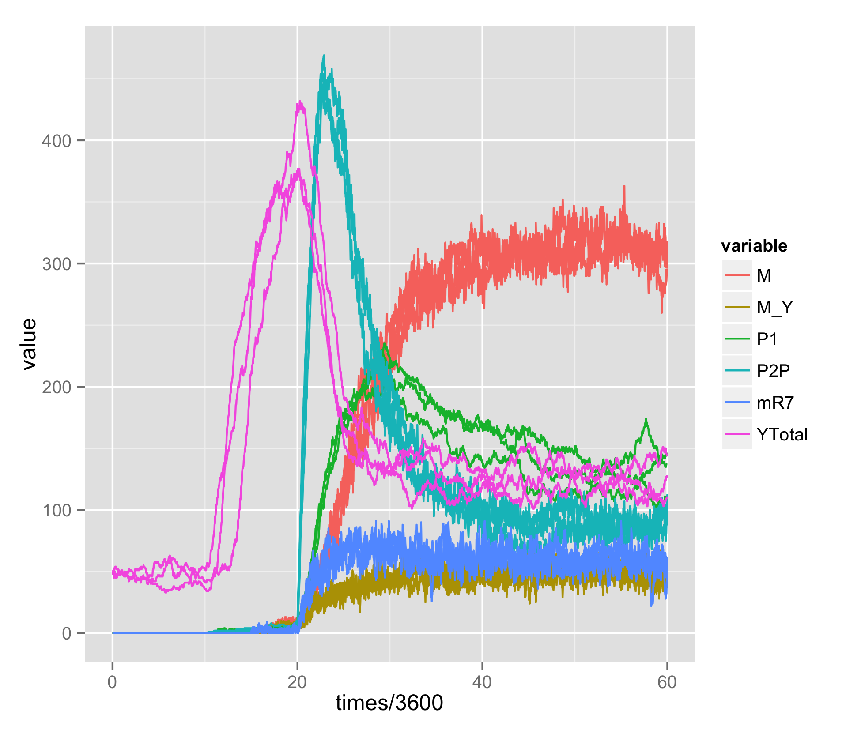
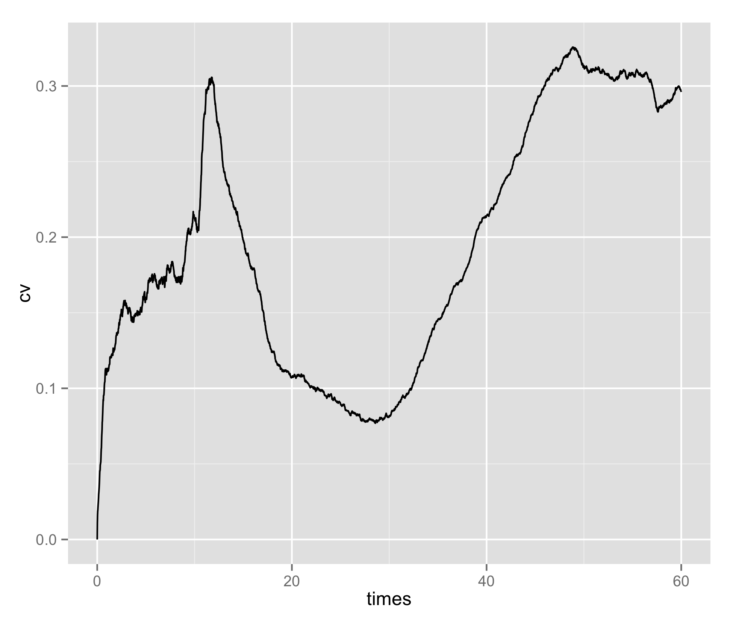
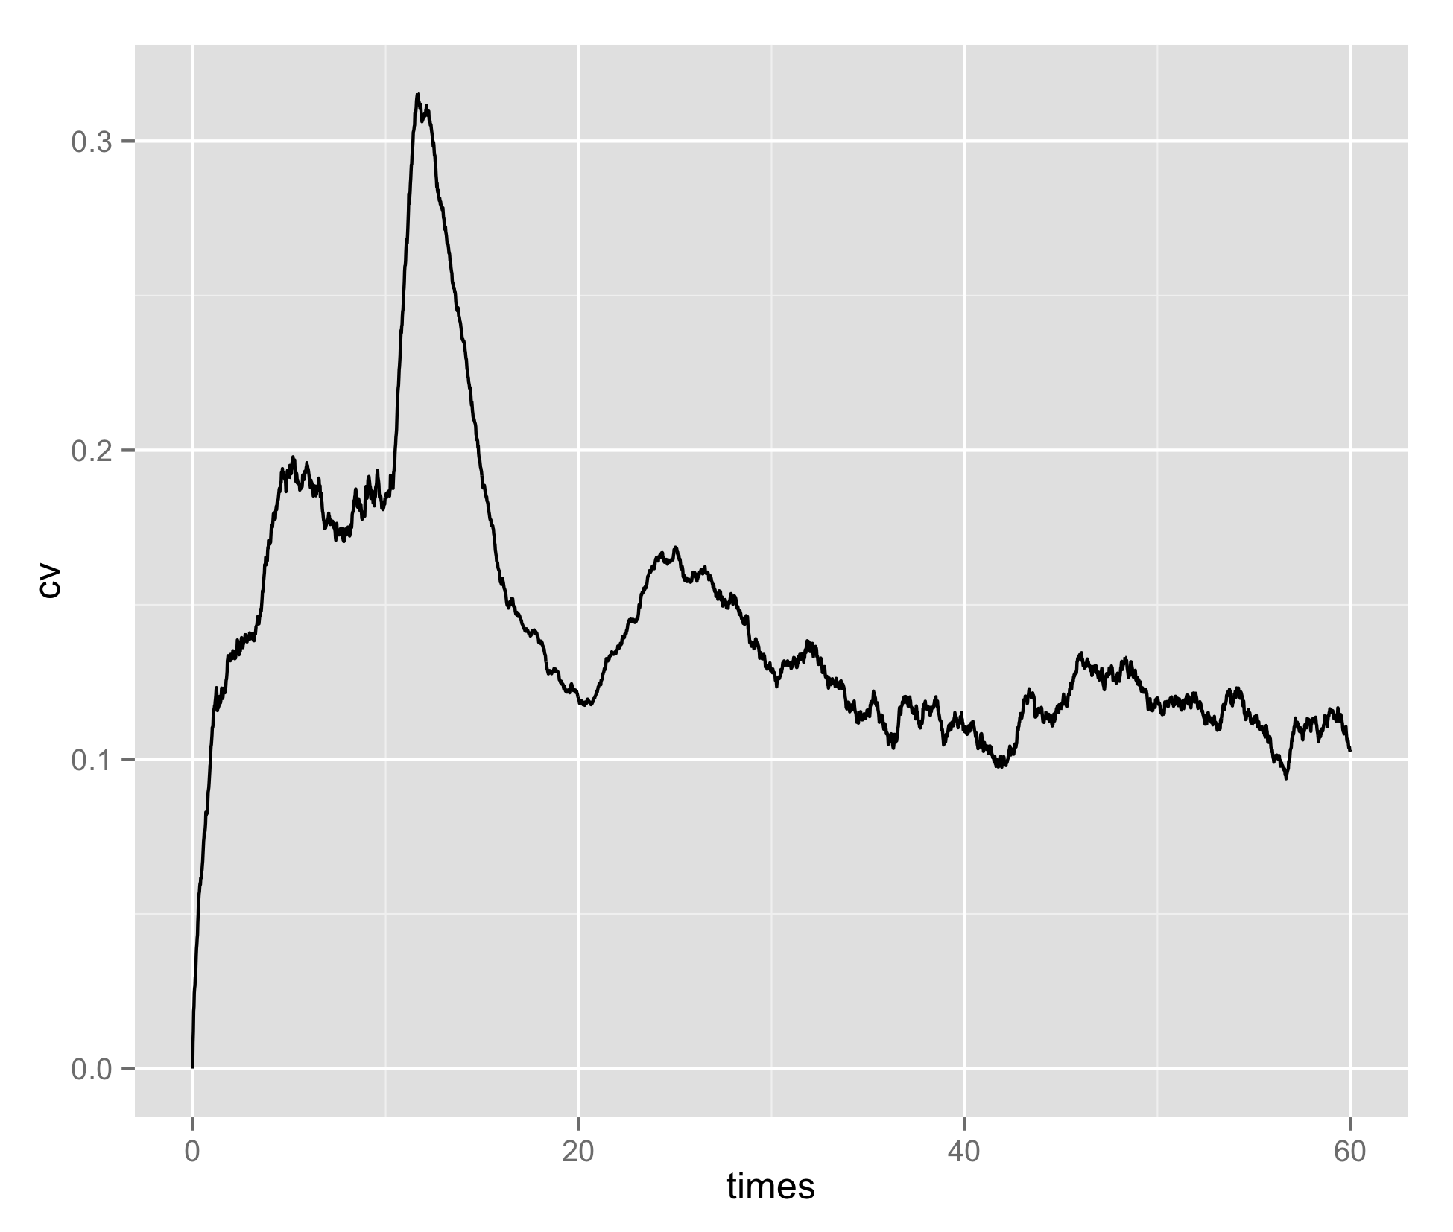
EGFR dependent transcriptional control of Yan
EGFR=0.02
4
EGFR
0.5

Slide 15
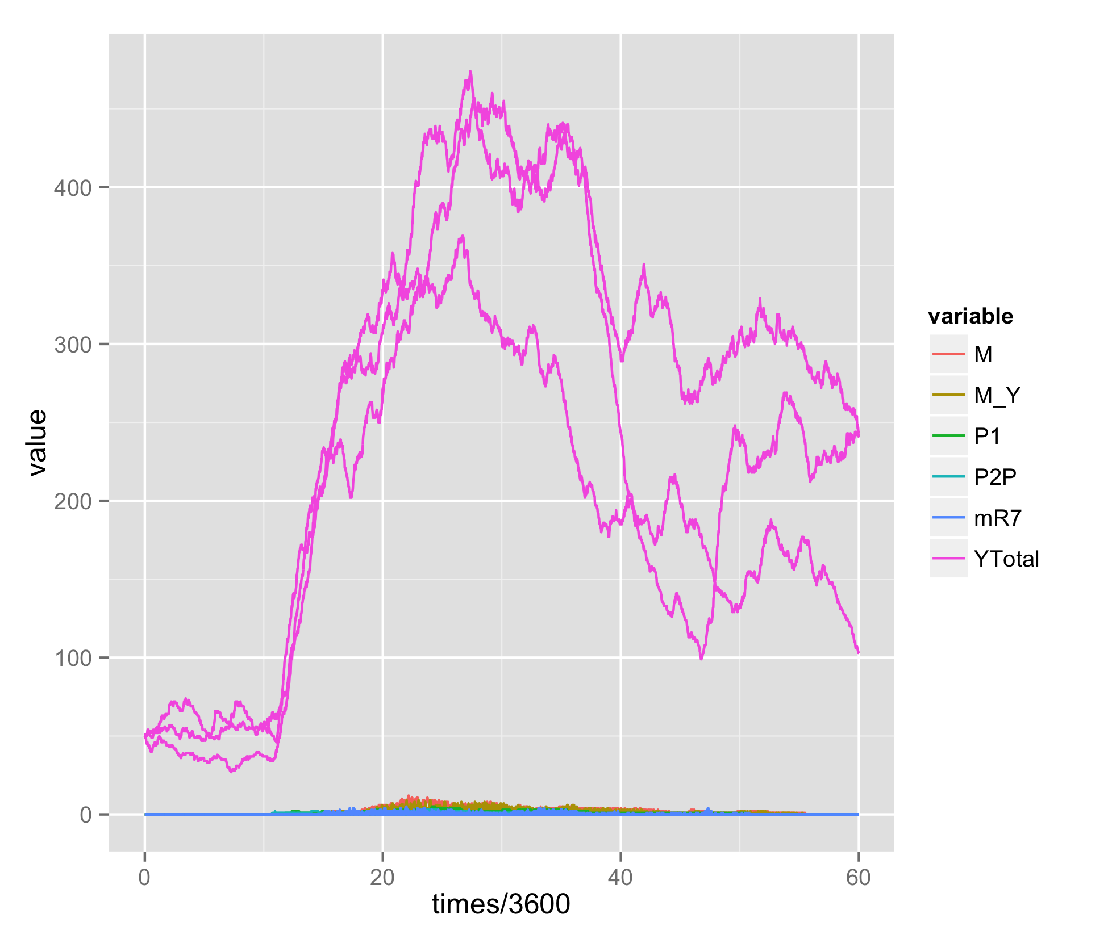
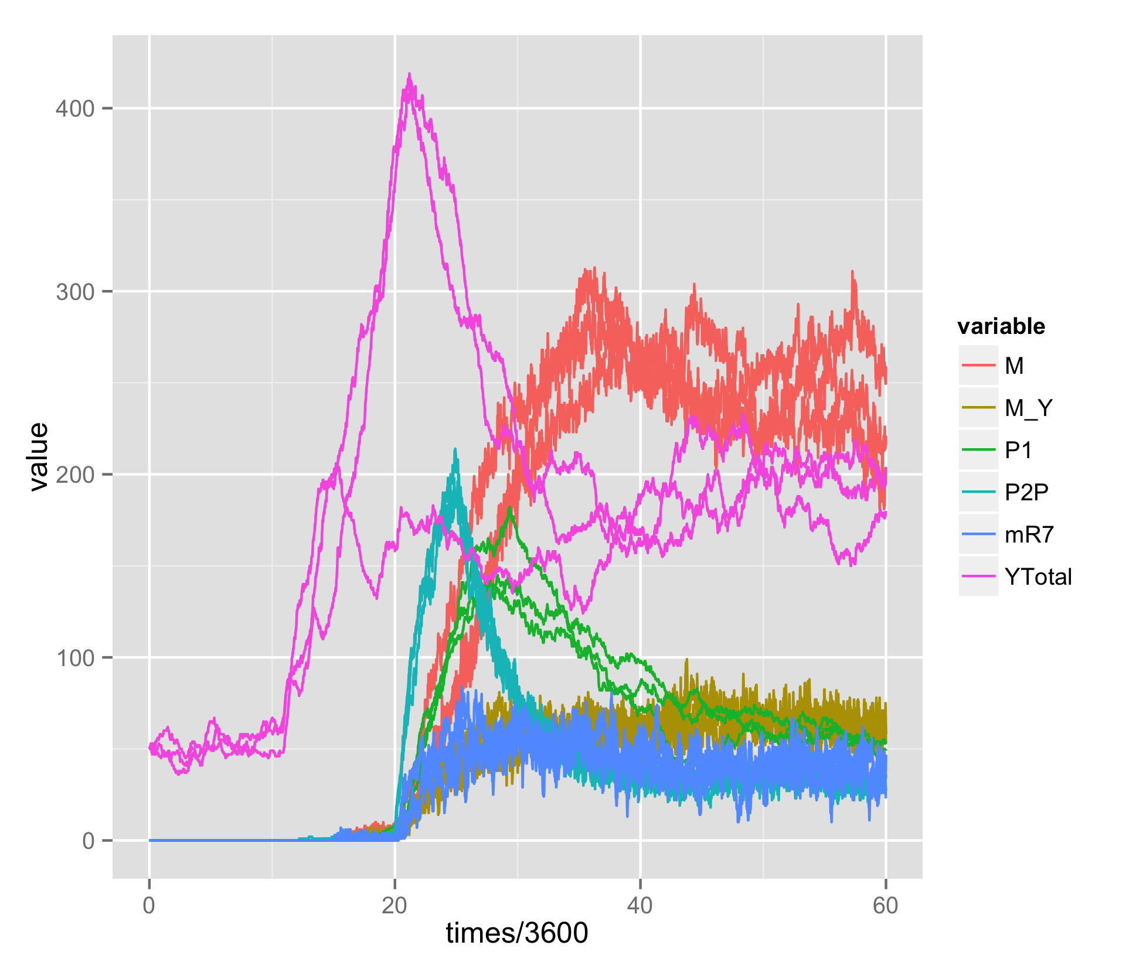
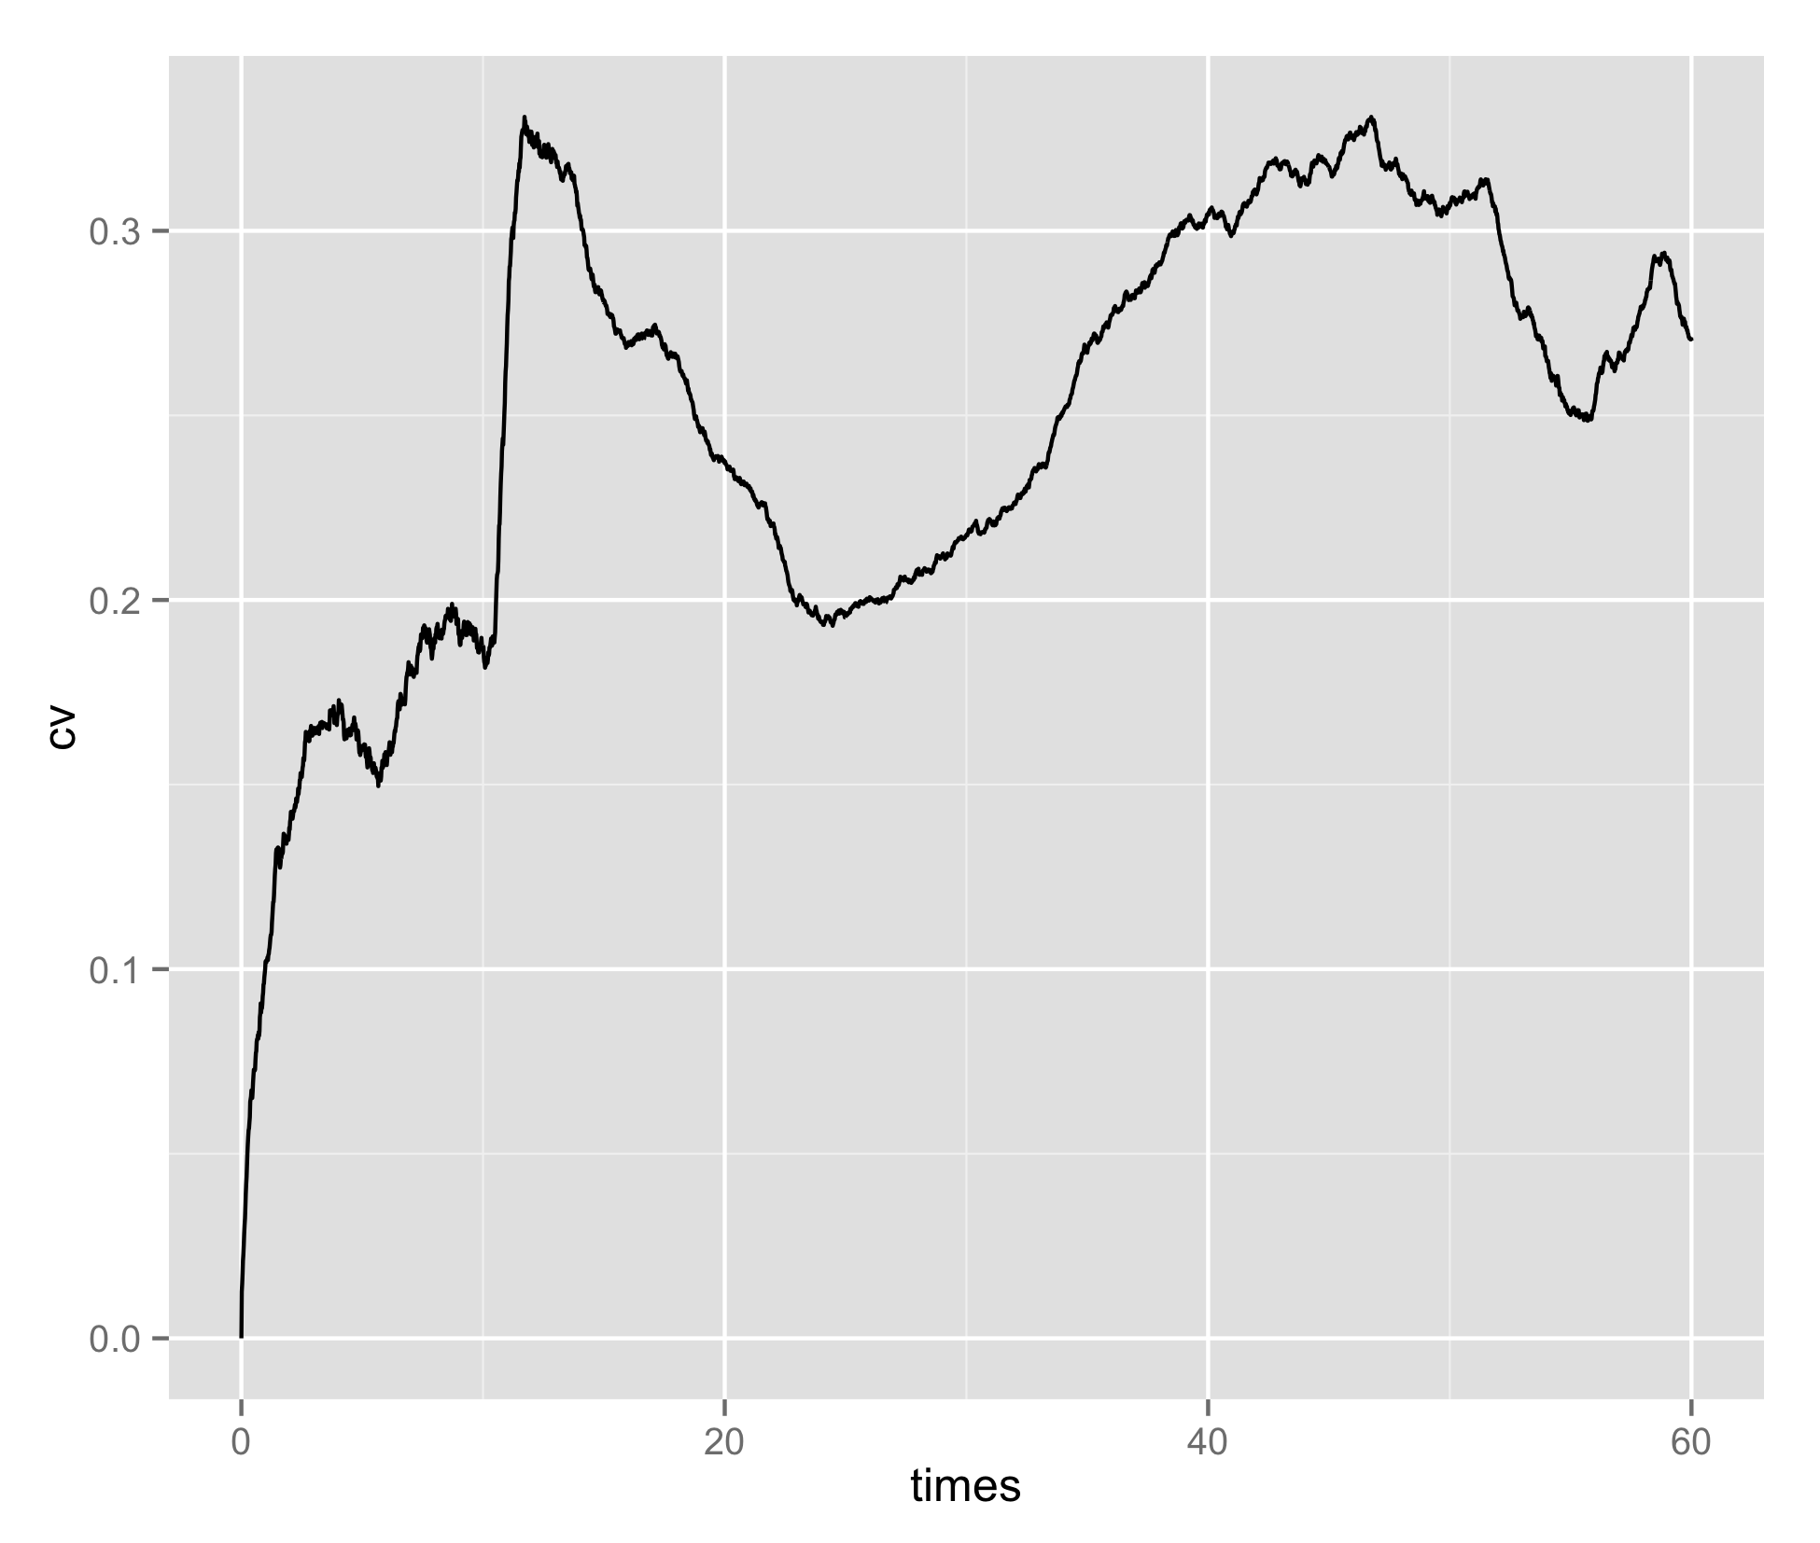
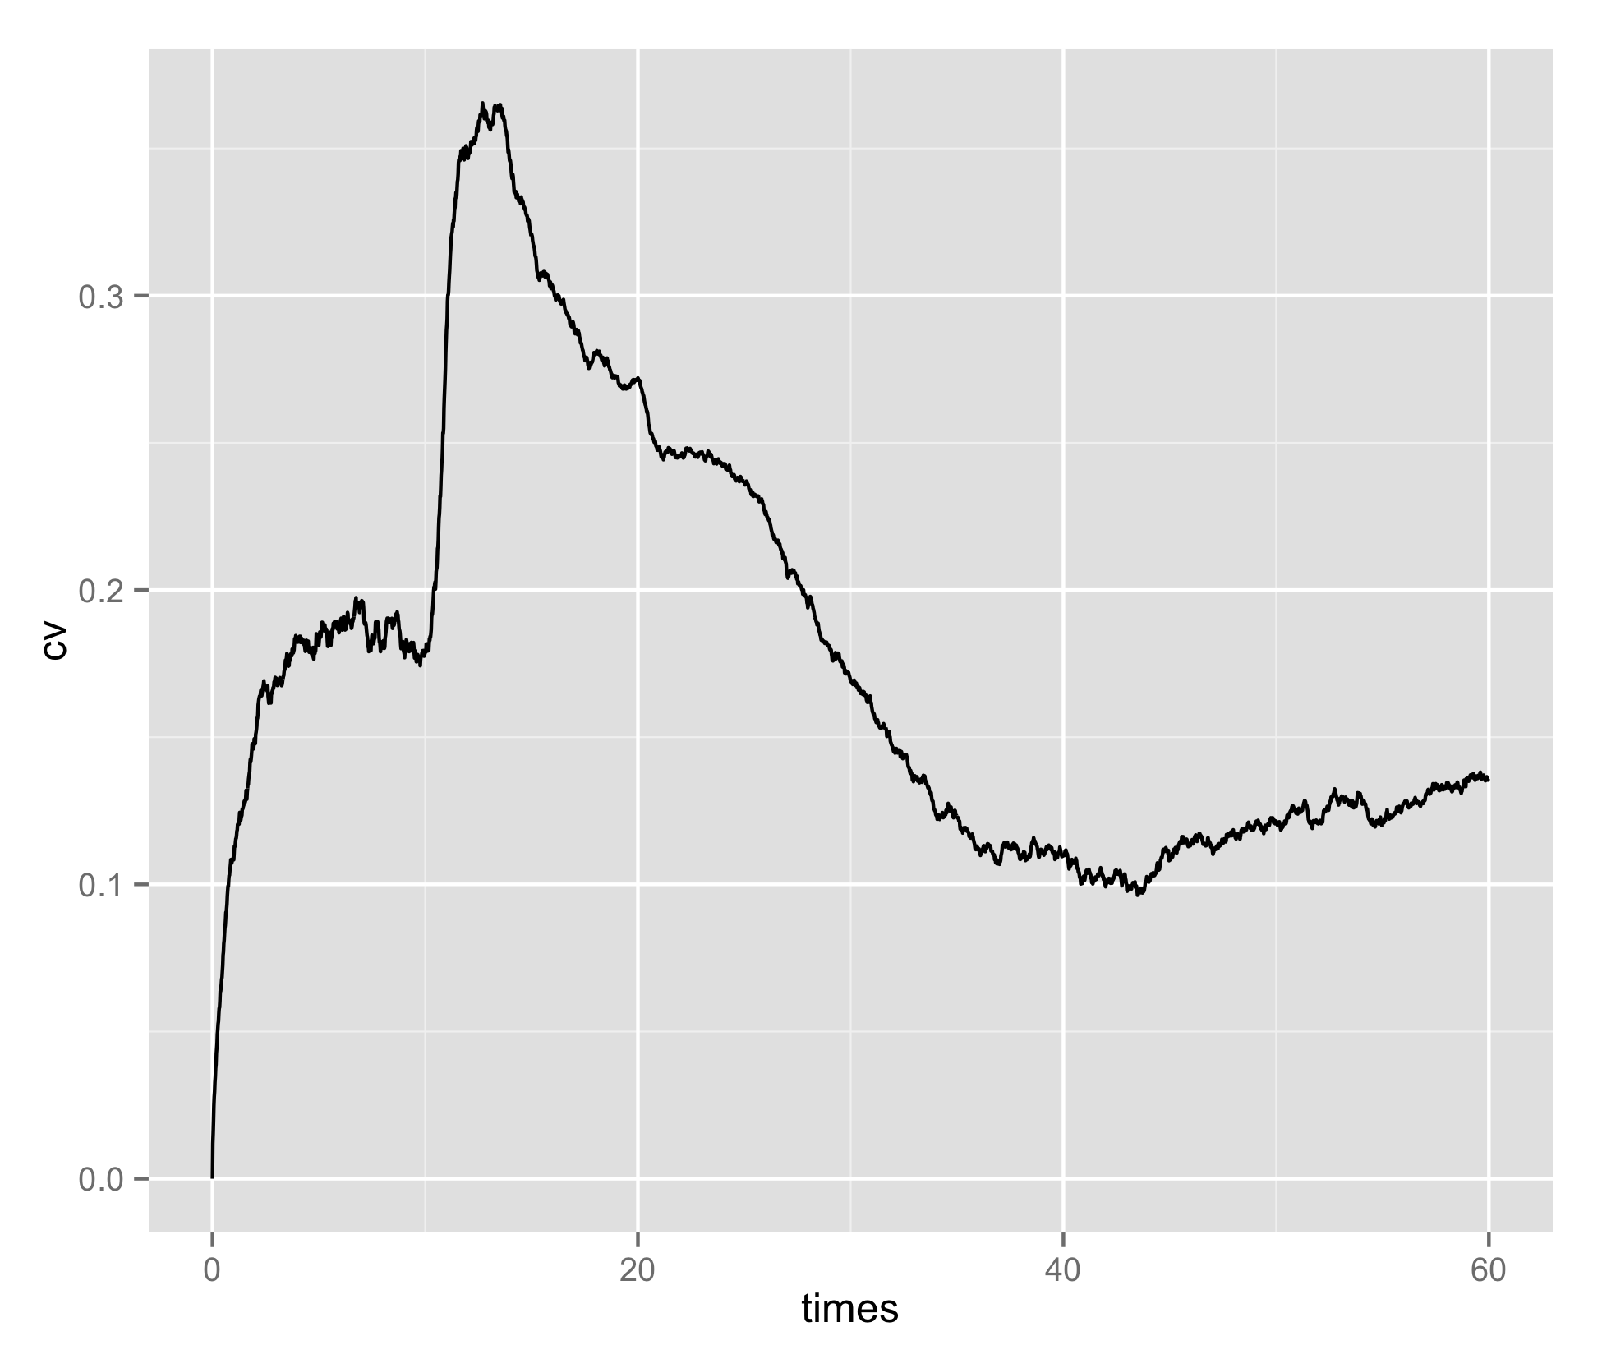
EGFR-TS (scaled by 0.3) transcriptional control of Yan
EGFR=0.006
1.2
EGFR
0.15

Slide 16
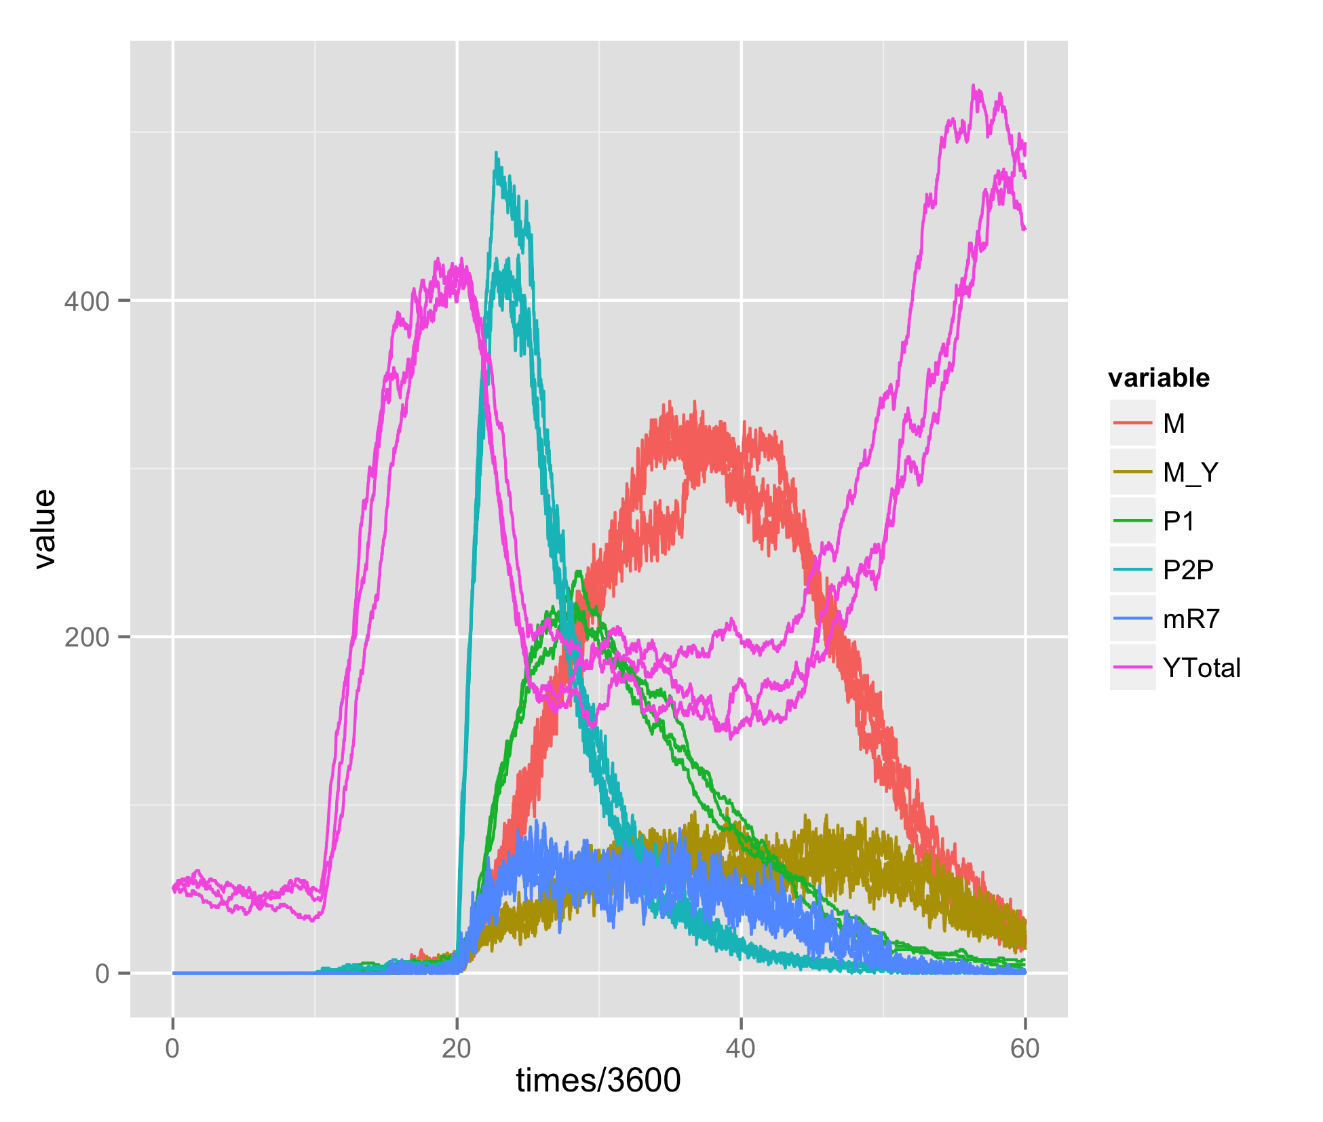
Unstable without extended EGFR signal
EGFR=4

